Slide 1

SRM INSTITUTE OF SCIENCE AND TECHNOLOGY
COLLEGE OF ENGINEERING AND TECHNOLOGY
DEPARTMENT OF NETWORKING AND COMMUNICATIONS
18CSP109L / 18CSP108L- MAJOR PROJECT / INTERNSHIP
Milan: An Interactive and Collaborative Environment for an Employee Intel Generator with Real-time Tracking
Rahul R
Reg No:RA1911031010025
Dev Shankar Tripathi
Reg No:RA1911031010048
Batch ID: NWC070
Guide name and Designation: Mrs. K Meenakshi, Assistant Professor, Department of Networking and Communications, SRM Institute of Science and Technology

Slide 2
Table of contents
Introduction
Problem Statement
Abstract
Innovation Idea
Objectives
Tech Stack
Stakeholders
Software Requirements
Architecture Diagrams
UML Diagrams
Literature Review
Methodology
Modules
Scope / Application
Software and Dataset
Dashboard Screenshots
Findings / Result
Conclusion

Slide 3
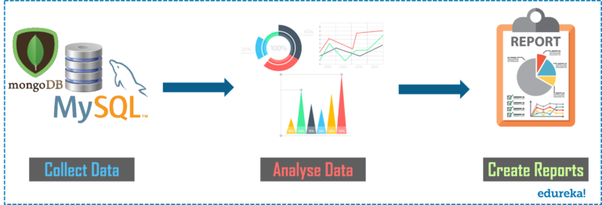
Introduction
Data Analytics refers to the techniques used to analyze data to enhance productivity and business gain. Data is extracted from various sources and is cleaned and categorized to analyze various behavioral patterns. The techniques and the tools used vary according to the organization or individual.

Slide 4

Problem Statement
Usually HR find it really hard to monitor the employee presence , WFH, hiring, performance insights etc. By leveraging HR data analytics, organizations can gain a better understanding of their workforce and identify areas for improvement. This can help them make data-driven decisions related to talent management, employee engagement, and organizational effectiveness. We’ll be creating tools that could be used by a HR of an organization to simplify their work and be more productive.

Slide 5

Problem Statement
The WhatsApp-Analyzer is a statistical tool designed to analyze WhatsApp chats. By processing chat files that can be exported from WhatsApp, it creates multiple plots that reveal insightful information, such as identifying the most frequently responded participant by a user. Our suggestion is to leverage dataset manipulation techniques to gain a deeper understanding of WhatsApp chats stored on our mobile devices.

Slide 6

Problem Statement
Individuals from diverse fields and backgrounds possess distinct personalities, which is also reflected in their writing style when crafting their resumes. Due to their diverse work experiences, each resume is unique and showcases their unique style. For professionals working in human resources, they often have to sift through hundreds of resumes online. After summarizing the resumes and inputting specific information into their database, executives then reach out to applicants for job counseling. However, this process is time-consuming as each resume can take around 10-15 minutes to summarize and enter into the database. To streamline this process, this project aims to automate the resume screening process.

Slide 7
Abstract
WhatsApp is currently the most popular and efficient communication application. Its chats contain a diverse range of conversations among various groups of people, covering a wide range of topics. This valuable data can provide essential insights for modern technologies, such as machine learning. The accuracy of a machine learning model is directly related to the quality of data that it receives. Hence, this tool aims to analyze WhatsApp data in depth, regardless of the topic of conversation.
Our developed code can be used to gain a better understanding of the data. We use simple Python modules, such as pandas, matplotlib, seaborn, and sentiment analysis, to create data frames and plot different graphs.

Slide 8
Innovation Idea
An innovative idea for HR data analytics would be to use natural language processing (NLP) to analyze employee feedback, performance reviews, and other textual data to identify trends, patterns, and insights. NLP is a branch of artificial intelligence (AI) that enables computers to interpret, understand, and generate human language. By applying NLP to HR data, organizations can gain valuable insights into employee sentiments, satisfaction levels, and areas of improvement.
The NLP-based HR analytics tool can use machine learning algorithms to analyze text data from various sources, such as employee surveys, performance reviews, exit interviews, and social media posts. The tool can identify and categorize keywords, phrases, and sentiments expressed by employees, providing valuable insights into employee engagement, satisfaction, and retention.

Slide 9
Objectives
HR data analytics can also help organizations identify patterns and trends in their workforce data, allowing them to make predictions about future workforce needs and proactively address potential issues.
Our developed code can be used to gain a better understanding of the data. We use simple Python modules, such as pandas, matplotlib, seaborn, and sentiment analysis, to create data frames and plot different graphs.
By applying NLP to HR data, organizations can gain valuable insights into employee sentiments, satisfaction levels, and areas of improvement.
The NLP-based HR analytics tool can use machine learning algorithms to analyze text data from various sources, such as employee surveys, performance reviews, exit interviews, and social media posts. The tool can identify and categorize keywords, phrases, and sentiments expressed by employees, providing valuable insights into employee engagement, satisfaction, and retention.

Slide 10
Tech Stack
Python: Scripting Language
Numpy,Pandas: Data Cleaning
Matplotlib: Data Visualisation
Scikit Learn : Model Building
Apache MySql : Backend Server
Jupyterlab,Vscode,Pycharm : IDE

Slide 11
Stakeholders
HR
Founder/MD
Managers
Employees
Investors

Slide 12
Software Requirements
Python, PowerQuery (BI)
Streamlit, Pandas,pyplot
Matplotlib,Seaborn
Scikit Learn, Pycharm
JupyterLab,VScode

Slide 13
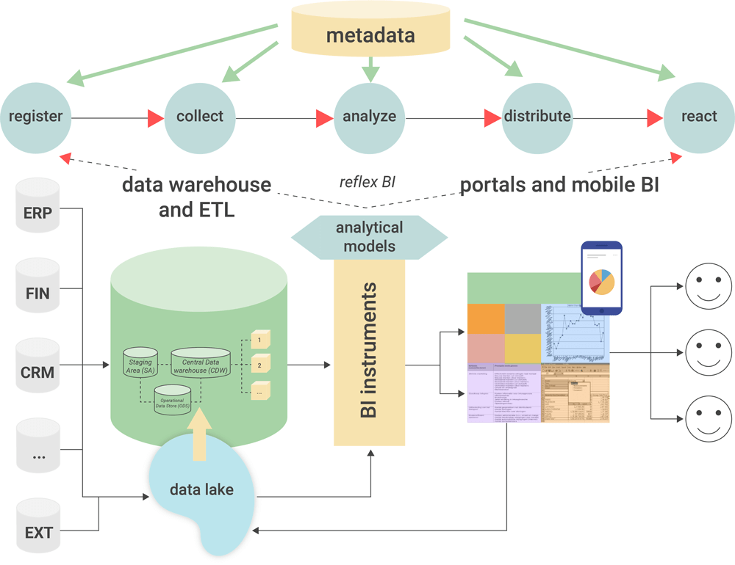
Architecture/ Block Diagram

Slide 14
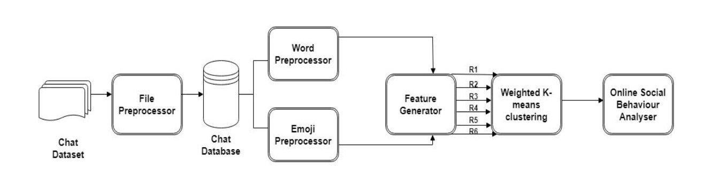
Architecture/ Block Diagram

Slide 15
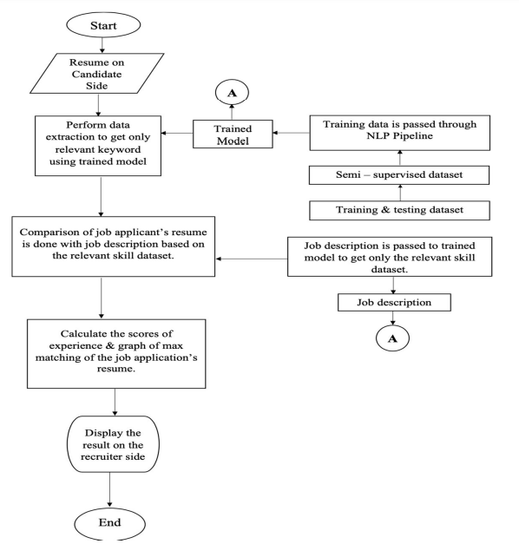
Activity Diagram for Resume Analyzer

Slide 16
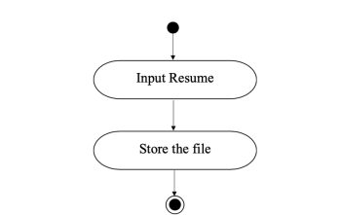
UML Diagrams
Activity Diagram for Accepting Resume as Input

Slide 17
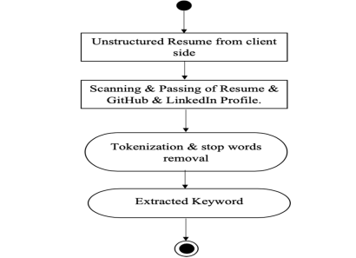
UML Diagrams
Activity Diagram showing how data extraction happens for resume

Slide 18
Literature Review
Author
Ravishankara K, Dhanush, Vaisakh, Srajan I S
Summary
WhatsApp chat analyzer is a tool that can be used to analyze WhatsApp chats and generate insights from them. Some of the features of this tool include:
Word frequency analysis: This feature allows you to identify the most commonly used words in your WhatsApp chat. This can help you understand the topics that you and your contacts frequently discuss.
Sentiment analysis: This feature can be used to analyze the sentiment of your WhatsApp chats. It can help you identify the positive, negative, and neutral sentiments expressed in your chats.
Conversation timeline: This feature allows you to visualize the timeline of your WhatsApp chats. It can help you identify the times when you and your contacts are most active on WhatsApp.
Contact analysis: This feature allows you to analyze your WhatsApp contacts. You can identify the contacts you chat with most frequently, the times when you chat with them the most, and the topics you discuss with them.
Overall, WhatsApp chat analyzer can be a useful tool for gaining insights from your WhatsApp chats and understanding your communication patterns with your contacts.

Slide 19
Literature Review
Demerits
Privacy concerns: Some people may be uncomfortable with the idea of their personal conversations being analyzed and stored, even if it is for personal use. Additionally, depending on the specific tool or software used, there may be concerns about data security or potential breaches.
Limited data analysis: WhatsApp chat analyzer can only analyze the data that is available to it. For example, it may not be able to analyze deleted messages or messages sent before the chat was analyzed. Additionally, it may not be able to accurately interpret sarcasm or humor, which could impact the accuracy of its analysis.
Limited usefulness: The insights generated by WhatsApp chat analyzer may not always be useful or actionable. For example, knowing the frequency of certain words or the sentiment of a conversation may not necessarily provide insights that can be used to make meaningful changes to your communication habits or relationships.
Cost: Some WhatsApp chat analyzer tools or software may come with a cost, which could make it inaccessible or unaffordable for some users.
Overall, while WhatsApp chat analyzer can be a useful tool for gaining insights from your WhatsApp chats, it's important to consider the potential demerits and determine whether the benefits outweigh the potential drawbacks.

Slide 20
Literature Review
Author
B.Kelkar, R.Shedbale, D.Khade, P.Pol, A.Damame
Summary
Resume analyzer NLP (Natural Language Processing) is a tool that uses machine learning and language processing techniques to analyze resumes and generate insights from them. Some of the features of this tool include:
Skills analysis: This feature allows you to identify the key skills and experience listed in a resume. It can help you quickly identify candidates who have the right qualifications for a job opening.
Experience analysis: This feature can be used to analyze the work experience listed in a resume. It can help you identify the candidate's level of experience and the types of roles they have held.
Language analysis: This feature allows you to analyze the language used in a resume, including grammar, vocabulary, and tone. It can help you identify candidates who have strong communication skills and are a good fit for your company culture.
Sentiment analysis: This feature can be used to analyze the sentiment expressed in a resume. It can help you identify candidates who are enthusiastic about the job opening and are a good fit for your company culture.
Overall, Resume analyzer NLP can be a useful tool for analyzing resumes and quickly identifying candidates who are a good fit for a job opening. It can save time and help ensure that you are selecting the most qualified candidates for the job.

Slide 21
Literature Review
Demerits
Lack of personalization: Resume analyzer NLP can only analyze the information that is available in the resume. It may not be able to take into account other factors, such as the candidate's personality, work style, or personal preferences. This lack of personalization could result in overlooking potentially strong candidates or identifying candidates who are not a good fit for the company culture.
Limited usefulness: The insights generated by resume analyzer NLP may not always be useful or accurate. For example, the tool may incorrectly identify certain skills or experience listed in the resume, leading to inaccurate assessments of a candidate's qualifications.
Bias: Resume analyzer NLP could potentially be biased towards certain candidates or against certain groups of people. This bias could be based on factors such as gender, race, or education level, and could result in unfair or discriminatory hiring practices.
Cost: Some resume analyzer NLP tools may come with a cost, which could make it inaccessible or unaffordable for some organizations or individuals.
Overall, while resume analyzer NLP can be a useful tool for analyzing resumes and identifying potential candidates for a job, it's important to consider the potential demerits and determine whether the benefits outweigh the potential drawbacks. Additionally, it's important to use the tool in conjunction with other hiring practices, such as interviews and reference checks, to ensure that the hiring process is fair and effective.

Slide 22
Methodology
As an attempt to overcome some of the major disadvantages of the existing system, the proposed system will eventually help in
reducing their workload of the company recruiters. Thus, the proposed solutions use various approaches with the aim of achieving automated screening of candidate’s resume that mainly focuses on the content of the resumes where we perform the extraction of skills and related parameters to match candidates with the job description of the company.
Overall Working Model: In the first step, the system accepts the resume from the aspiring job applicants and performs keyword extraction on it.
A. Client Side
In this part the job aspiring candidate will upload their resumes for screening which mainly consist of two important modules i.e.;
‘Accepting Resumes as Input’ and ‘Keyword extraction module’.
1) Accepting Resume as Input

Slide 23
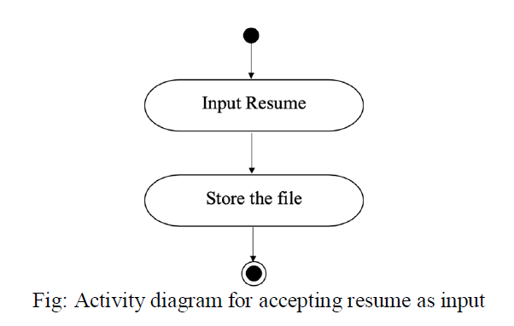
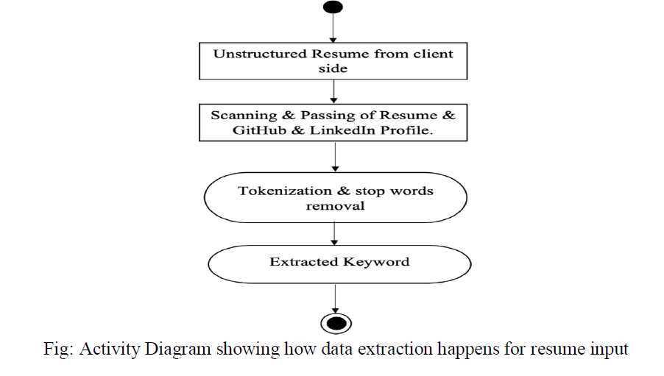
Methodology
2) Keyword Extraction Module: This module deals with scrapping keywords from the resume in order to compare those with the
job profile description so as to decide whether the resumes are shortlisted for further job recruitment process or not based on their education, experience and other information captured on their resume. This keyword extraction is done using section based segmentation with Natural language Processing.

Slide 24
Modules for HR Data Analytics
Register
Collect
Analyze
Distribute
React

Slide 25
Register
Registration data can only be usefully analysed if the data collected at registration is representative, of a good quality and regularly updated. Relying on registration data of five years ago will likely not provide an accurate picture of the needs and circumstances of the requirement today.
As such, a good registration system also includes mechanisms to manage its data, making it reliable and effective for planning and programming.

Slide 26
Collect
Data collection is the procedure of collecting, measuring and analyzing accurate insights for research using standard validated techniques.
A researcher can evaluate their hypothesis on the basis of collected data. In most cases, data collection is the primary and most important step for research, irrespective of the field of research. The approach of data collection is different for different fields of study, depending on the required information.

Slide 27
Collect
Data collection is the procedure of collecting, measuring and analyzing accurate insights for research using standard validated techniques.
A researcher can evaluate their hypothesis on the basis of collected data. In most cases, data collection is the primary and most important step for research, irrespective of the field of research. The approach of data collection is different for different fields of study, depending on the required information.

Slide 28
Analyze
Analyze is defined as a process of cleaning, transforming, and modeling data to discover useful information for business decision-making. The purpose of Analyze module is to extract useful information from data and taking the decision based upon the data analysis.
A simple example of analysis is whenever we take any decision in our day-to-day life is by thinking about what happened last time or what will happen by choosing that particular decision. This is nothing but analyzing our past or future and making decisions based on it. For that, we gather memories of our past or dreams of our future.

Slide 29
Distribute
Distribution describes the manner by which a product or products are made available to the consumer.
Every sale includes a primary seller, who provides the service or product, and a buyer who purchases the service or product.
Direct Distribution
Using this type of distribution strategy, goods are sold by the manufacturer directly to consumers.

Slide 30
React
Reaction from the customers after using the dashboard
Get valuable feedback from customers and fix it by rolling out successive updates.

Slide 31
Scope/ Application
Presence Insights:
1. Infrastructure reduction or upgradation can be done based on the number of employee coming to office to work . For instance lets say there were only few employees coming to work in the office during the covid lockdown. Therefore the organization can take a data driven decision to vacate some of the floors
2. Team Building Activity Planning can be undertaken based on the presence of maximum number of employees
WhatsApp Analyzer:
1. Most Active person can be identified in the group.
2. The most active day in the week can be identified.
3. The commonly used words can be segregated .

Slide 32
Software and Dataset
Python: Scripting Language
Numpy,Pandas: Data Cleaning
Matplotlib: Data Visualisation
Scikit Learn : Model Building
Apache MySql : Backend Server
Jupyterlab,Vscode,Pycharm : IDE
Pyplot: Graphs, Charts

Slide 33
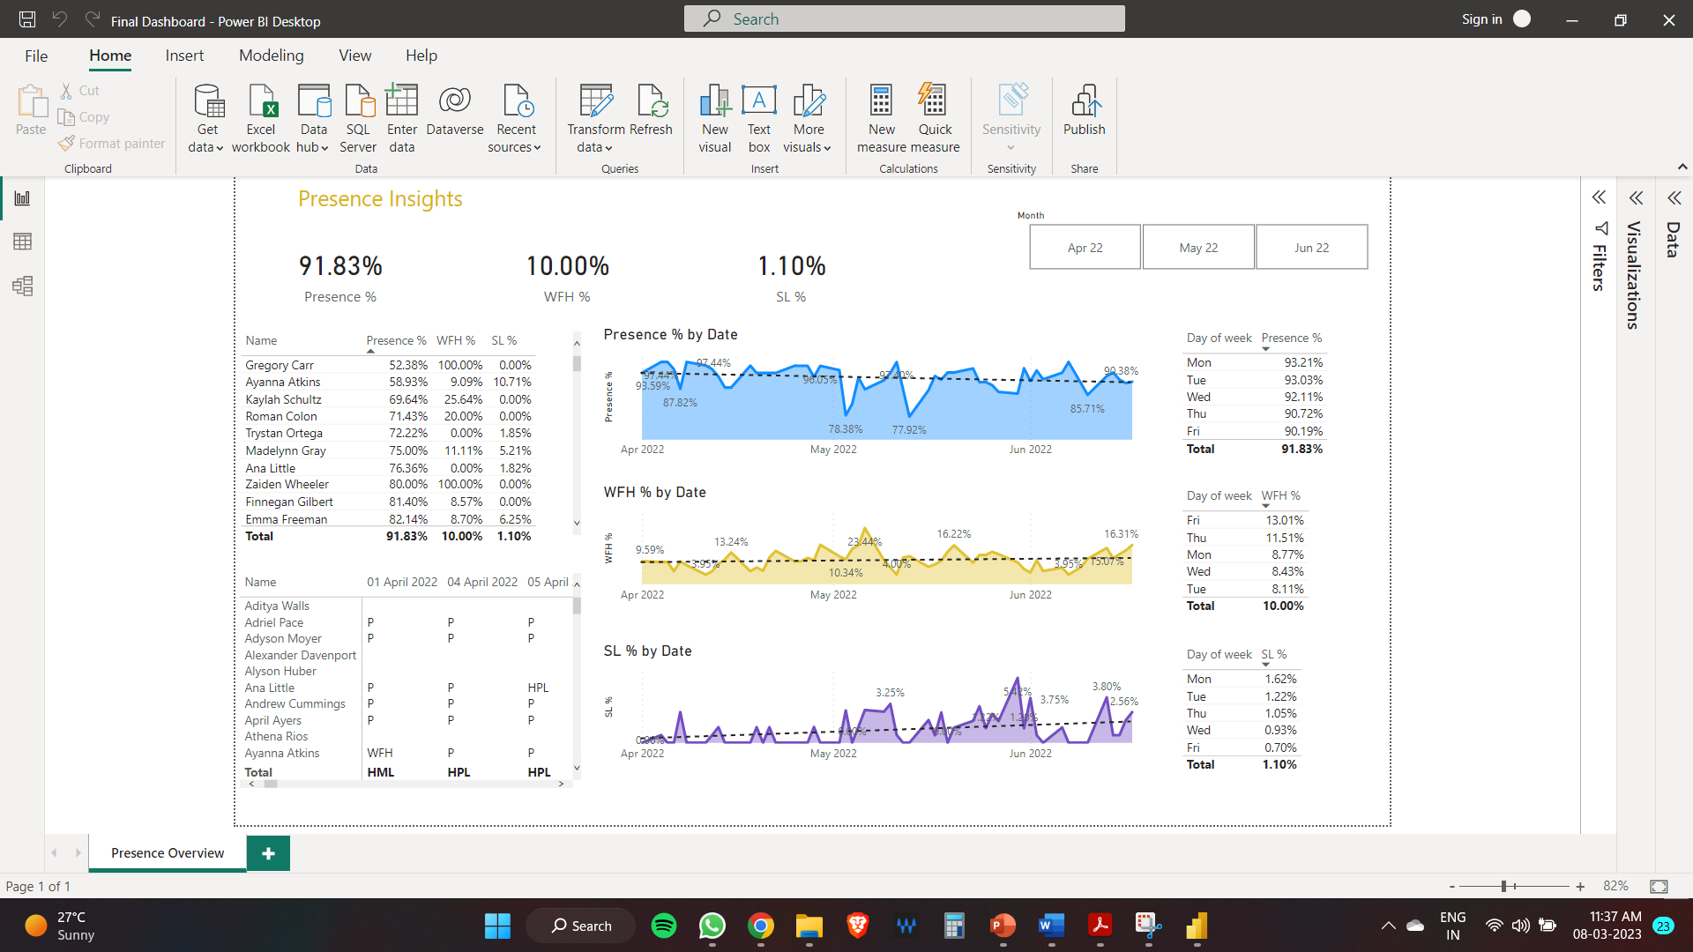
Dashboard

Slide 34
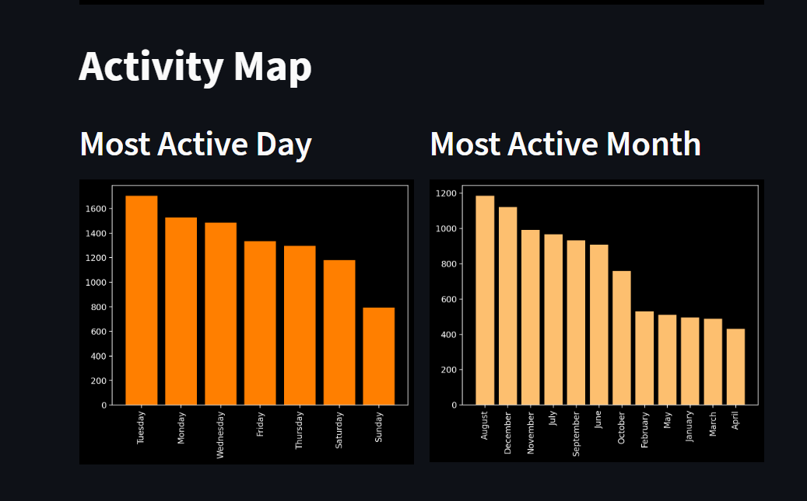
WhatsApp Analyzer

Slide 35
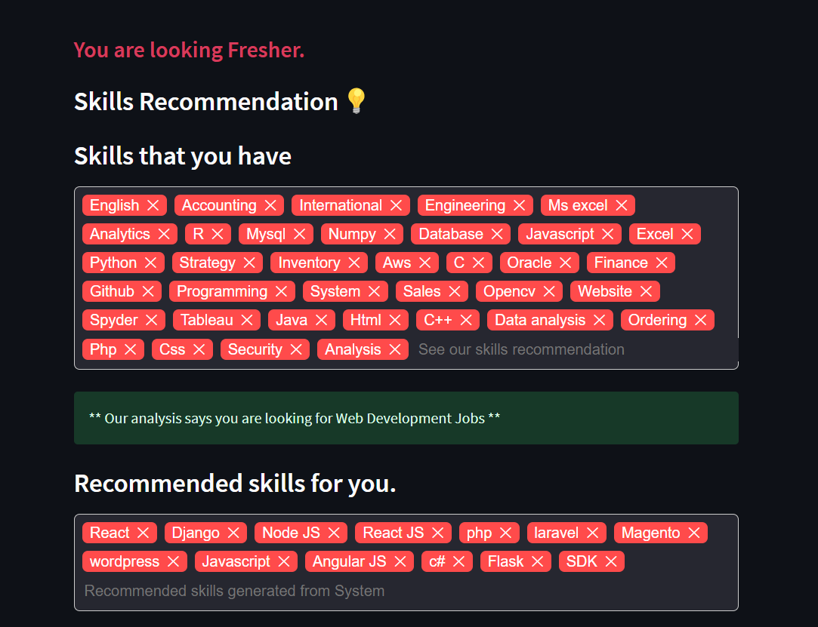
Resume Analyzer

Slide 36
Findings/Result
An automated dashboard providing quick and latest HR insights in order to support data driven decision making.
A chat analyzer that generates insights about an individual or a group. Information regarding the keywords used, top participants , sentiment or the tone of the conversation can be generated .
A smart resume analyzer that can identify the key skills and qualification of a person . It has the ability to evaluate the candidates experience and education. Finally the analyzer provides recommentations for improving the candidates resume .

Slide 37
Conclusion
An integrated dashboard offering rapid and current HR insight in hopes of facilitating information-driven decision making. Some possible insights that can be derived from analyzing WhatsApp chats include identifying the most active participants in a conversation, tracking the frequency and patterns of message exchanges, identifying regularly used words or phrases, and discovering trends or subjects that arise over time. These insights might be valuable for understanding communication patterns and social dynamics inside a group chat or for doing research on the language and discourse used in WhatsApp discussions.
We have recommended this technique to make it easy for the recruiter to select candidates. It also displays the information in a standardized format. The raw data we acquired through the resumes is normalized, clustered and scored to display the top applicants. We have also incorporated the recruiters demands while rating the resume, therefore making it recruiter specific.

Slide 38
Thanks

